Slide 1
CollabNest
Application overview and Mid-defense Presentation

Slide 2
Agendas
Introduction
Purpose of CollabNest
Key Features
Methodologies and tools used
Different pages of Application
Diagrams & Figures
Conclusions

Slide 3
Introduction
Welcome to the world of CollabNest, where teamwork meets innovation. It is a collaboration and task management tool making day-to-day work at office easier.
Objectives
In this presentation we will see the implementation of proposed project "CollabNest" which is a collaboration and task management platform

Slide 4
Purpose of CollabNest
Our purpose to create a platform which provides effective communication and collaboration within the team members , connecting employees of on-site as well as remote working together to accomplish the task. The platform will empower organizations with the tools they need to thrive in a collaborative, data-driven world.

Slide 5
Key Features:
Task Scheduling
Projects Scheduling
News feed
Chats
User Profile
User Friendly Design

Slide 6
Methodologies and tools Used
Methodologies:
In this project, we are using Incremental approach to complete the task where we would build module by module. This approach will align with our goals and plan to conduct the project.
Tools Used:
Following different tools and languages are used to build this innovative product :
Project Management : Jira
Prototyping tools :Figma
Version Control tools: Git ,GitHub
Software Development : Flutter, Express JS, Node JS
API Development and testing : Postman
Database : MongoDB
Drawing tools: draw.io

Slide 7
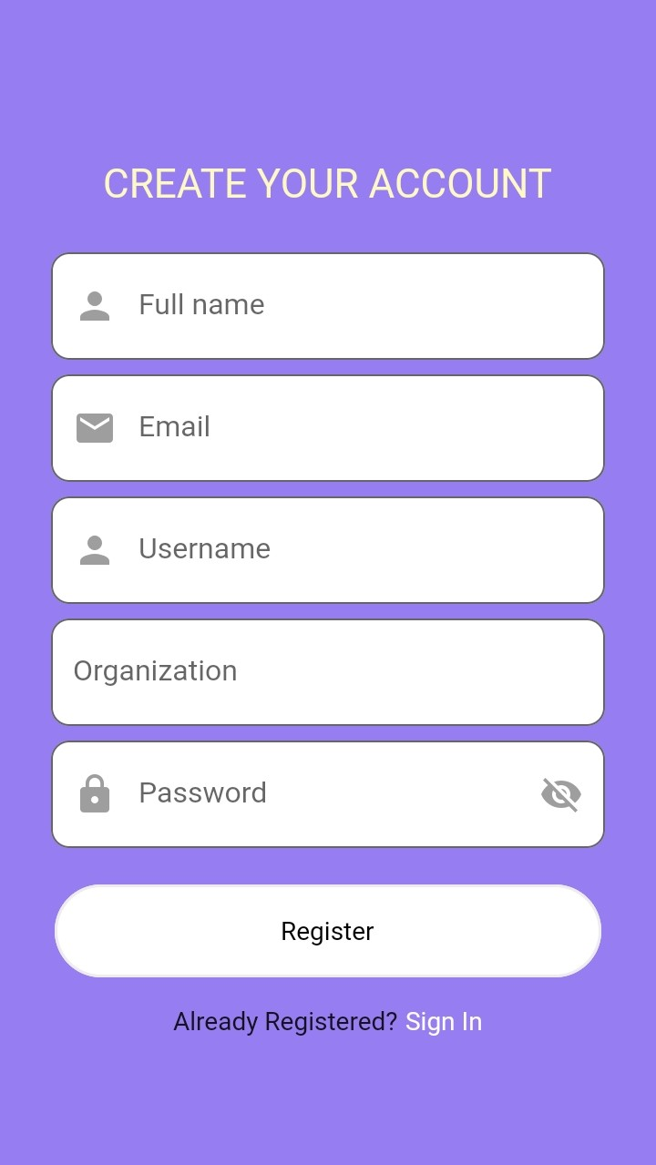
Registration
Using Registration page, individuals can register on basis of his/her name, username, email, password and organization name to register as a user to use this application. Registered users' detail will be saved safely.

Slide 8
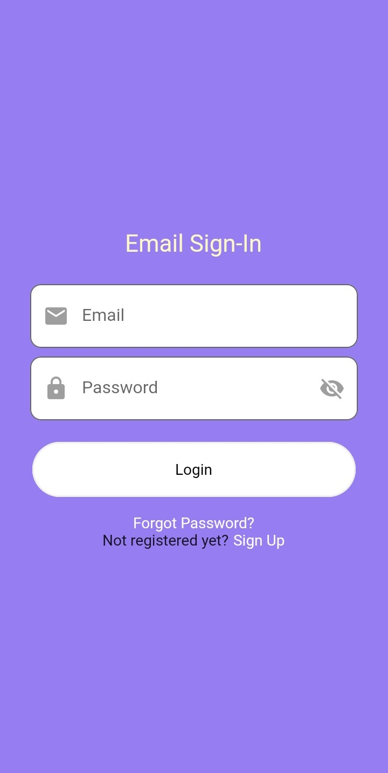
Login
Using Login Page, individual users can login on basis of his/her email and password name to login into the account and use this application.

Slide 9
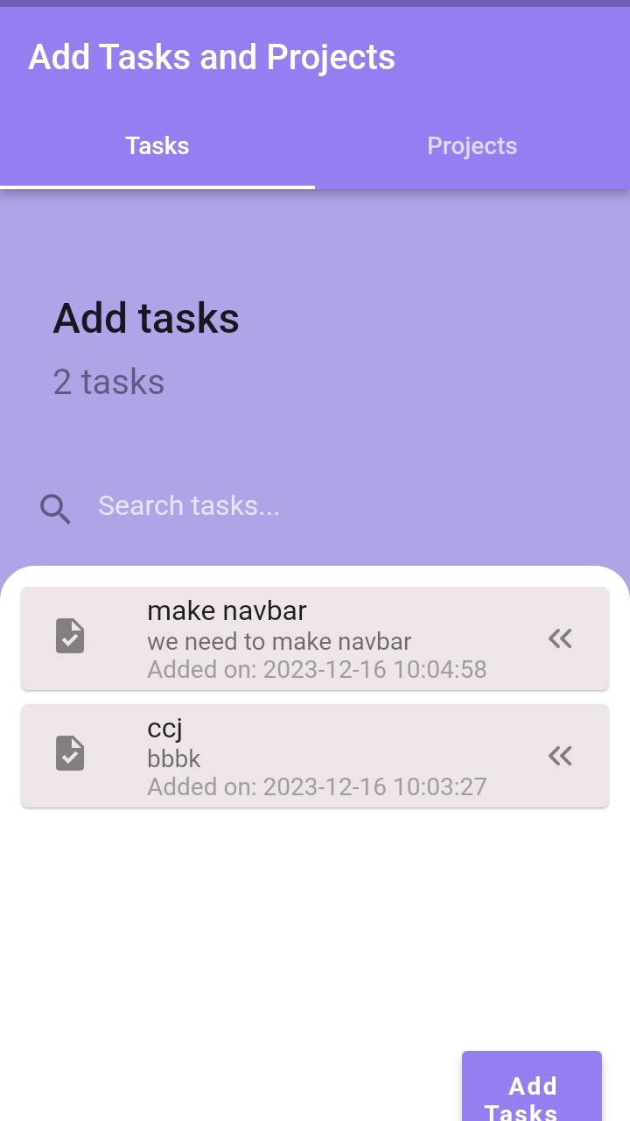
Task Scheduling
Using our Task Page in our application,we can perform tasks scheduling by adding tasks which we can do in future .After we perform our tasks we can delete it later and add other tasks if required.

Slide 10
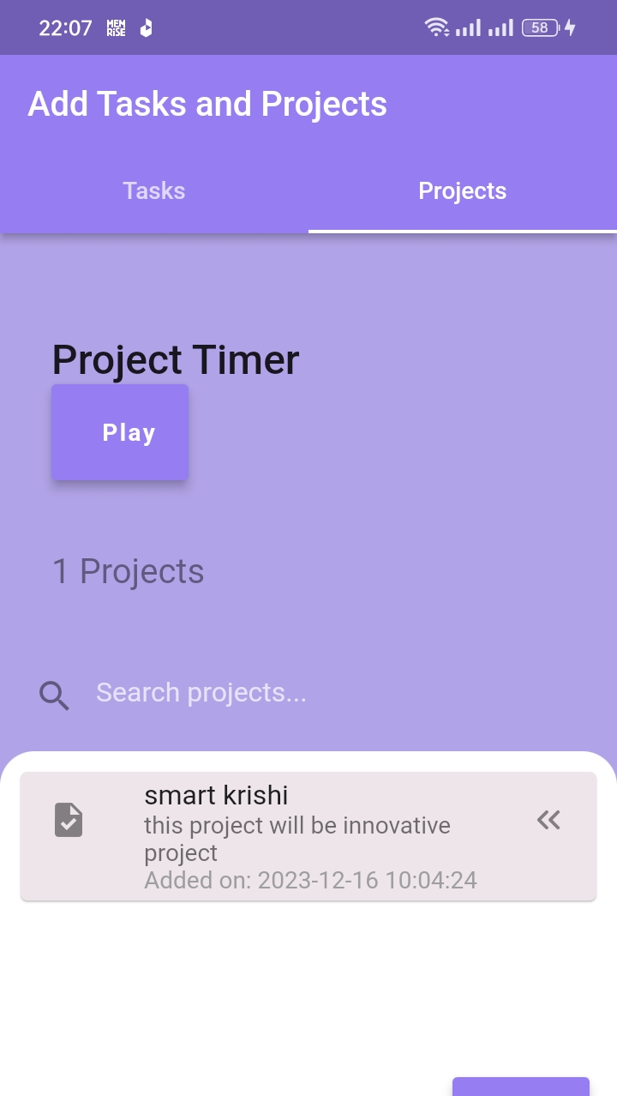
Project Scheduling
Using our Project Page in our application, we can schedule our projects so that we can do in future .After we complete our proejcts, we can delete it later and add other projects if we are assigned.

Slide 11
News feed
Using our News feed page in our application, we can view whoever has uploaded different notices and posts ,which will be very helpful to get information which we require. This page will be very helpful to provide information to everyone at a time .It will keep people connecting.

Slide 12
Chats
Using our chats page in our application, we can chat with different people in our organization so there is no need of skype and other messaging channels to convey information to each other

Slide 13
User profile
We have also set up individual user proile where we can see how many tasks he has and also the name of his/her ongoing projects,email address ,username and full name

Slide 14
Implementation of algorithms
In our application ,we have implemented two algorithms namely quick sort and binary search to sort and search tasks and projects on the basis of the timestamp at which project or task is added. We have used Quick Sort as it sorts data very quick just as its name with average time complexity of O(n log n) . Here as stored data is sorted in terms of timestamps, we have implemented Binary Search which is very fast having time complexity of O(log n).
When a user add tasks/ projects its added time is kept saved and comparing the timestamp, we perform search and sort operation. When we add task or projects, created timestamp is noticed and saved accordingly and when we search for the required tasks/project ,it compares timestamp of text in search bar with of list to search for the result .

Slide 15
Future Development
Tailored Training programs
02
24/7 services
01
Regular Updates
03
Community Engagement
04

Slide 16
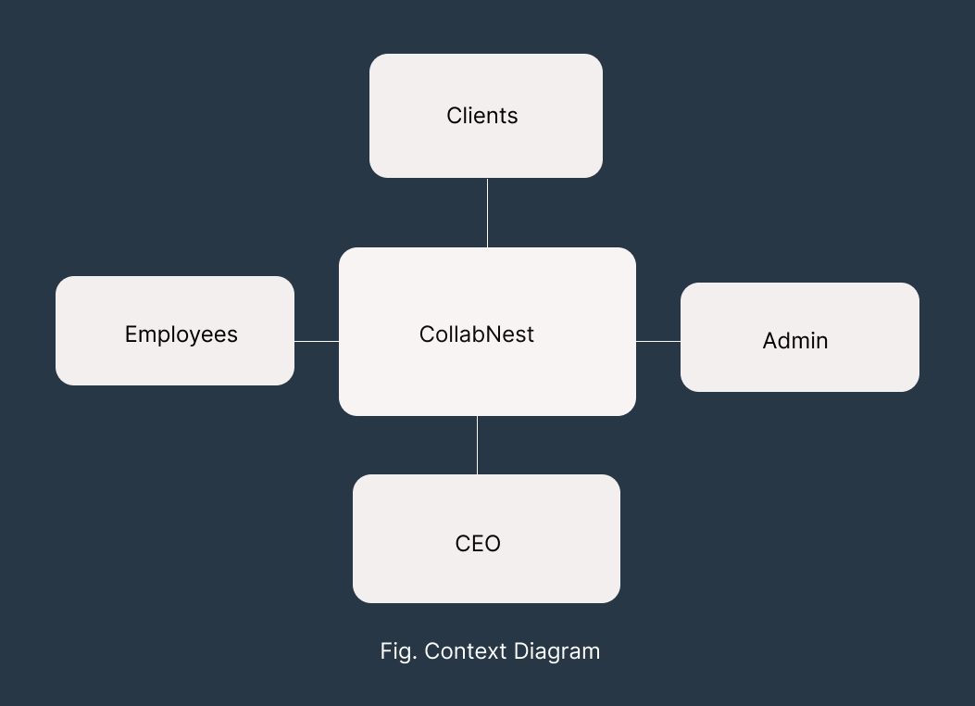
Diagrams and Figures
Fig .Context Diagram

Slide 17
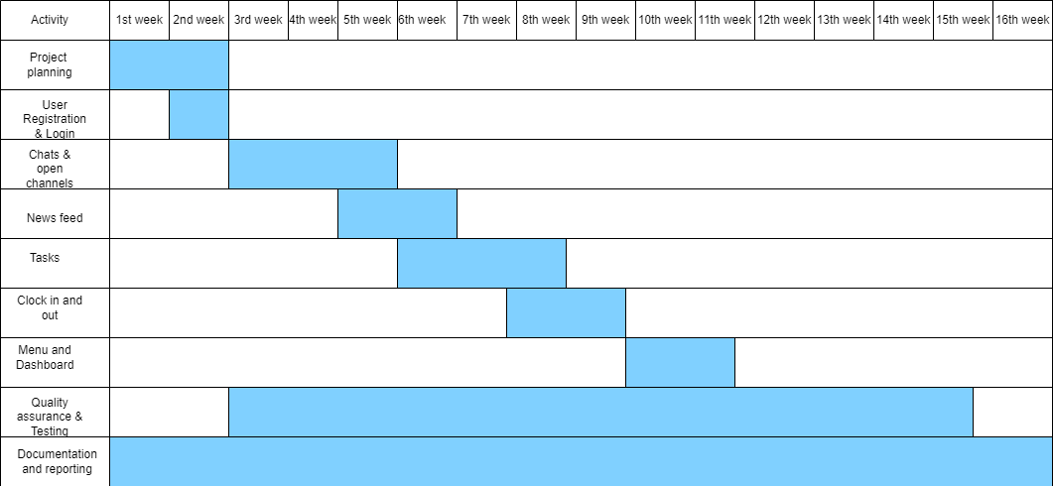
Diagrams and Figures
Fig . Gantt Charts

Slide 18
Conclusion
In summary, CollabNest stands as the solution to past collaboration challenges. With its intuitive interface, robust support, and tailored training, CollabNest empowers teams to overcome communication gaps and streamline workflows. As we embrace a future of seamless collaboration, CollabNest is your catalyst for enhanced productivity, efficient project management, and successful team

Slide 19
Thank you
Prakash Basnet
&
Rakshya Bastola

